Slide 1
Hello everyone, Welcome to MasterSoft student Login.
Let’s understand how you can Successfully Complete Online Registration Process.

Slide 2
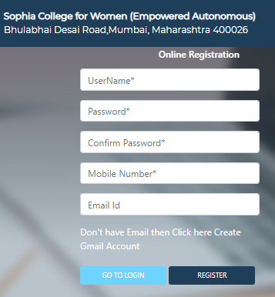
USER CREATION
Step1: Click on https://enrollonline.co.in/Registration/Apply/SCWM to visit Student Portal and then Create New Student Account on the portal by filling the required details such as Username, Password, Mobile Number and Email ID as shown below. Once you complete filling all the required details then click on Register button present on the screen.

Slide 3
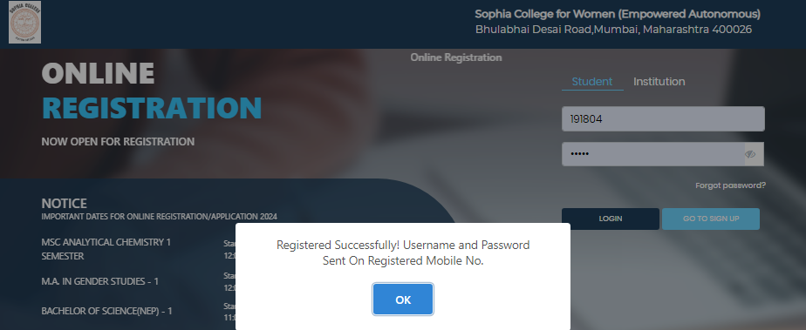
GET USERNAME & PASSWORD THROUGH MOBILE/EMAIL
Step2: Once you finish Creating New Student Account, You will be able to see a pop-up message saying that (Registered Successfully! Username and Password Send On Registered Mobile No). Press “OK” to continue
DEMO
DEMO COLLEGE
Andheri (East), Mumbai - 400069

Slide 4
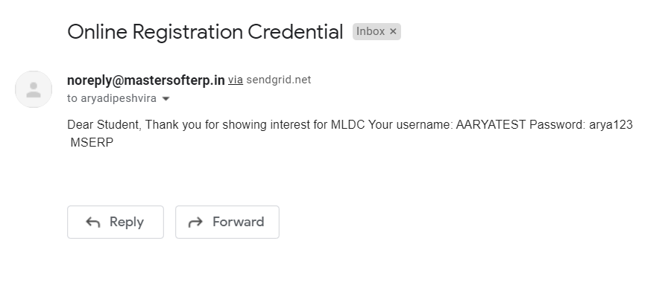
TEXT MESSAGE CONFIRMATION
Step3: On entering the mobile number, username and password will be generated and send on your registered Mobile Number or Email-id Respectively.
Student
MOBILE NUMBER
Student@123
Student and Password is: Student@123
EMAIL ID

Slide 5
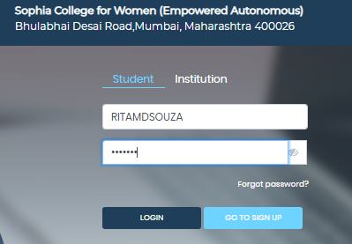
STUDENT LOGIN
Step4: Click on “Go To Login” button present on the bottom of screen. Now enter the credentials which you have received and click on the login option to Successfully Login To The System.

Slide 6
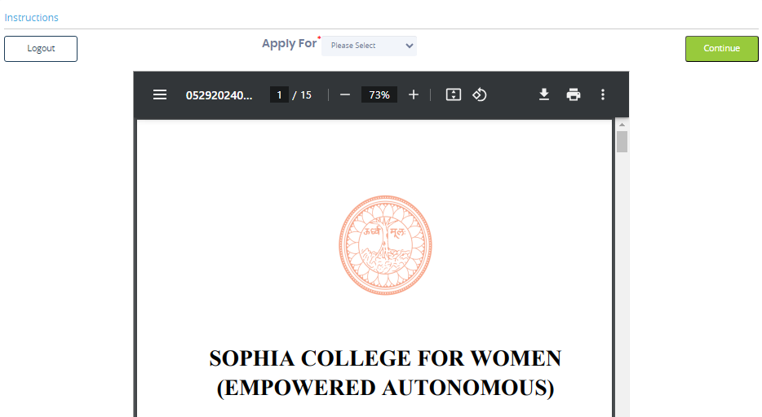
TERMS AND INSTRUCTIONS PAGE
Step5: This is Terms and Condition Page. Here student have to simply click on “Accept” button to proceed further.

Slide 7
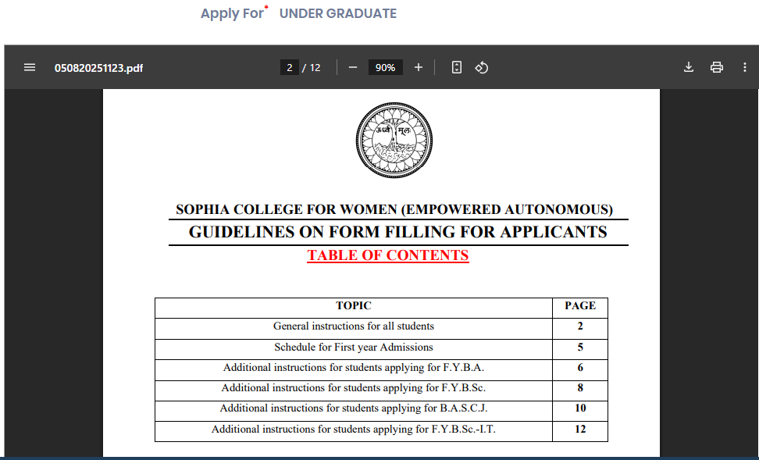
COURSE LEVEL SELECTION
Step 6: Select Course level UNDER GRADUATE using drop down
To proceed further click on “Continue” button.

Slide 8
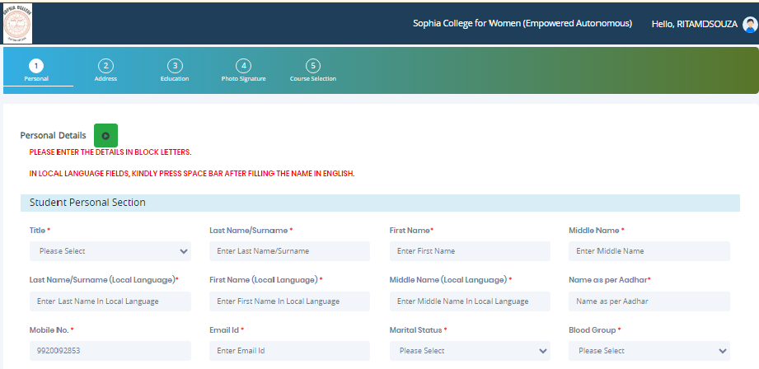
PERSONAL DETAILS
Step7: This is Personal Details Page, here student need to enter their Personal Details Such as first name, middle name, last name, email, gender etc. (Please note that all the red mark fields are mandatory).

Slide 9
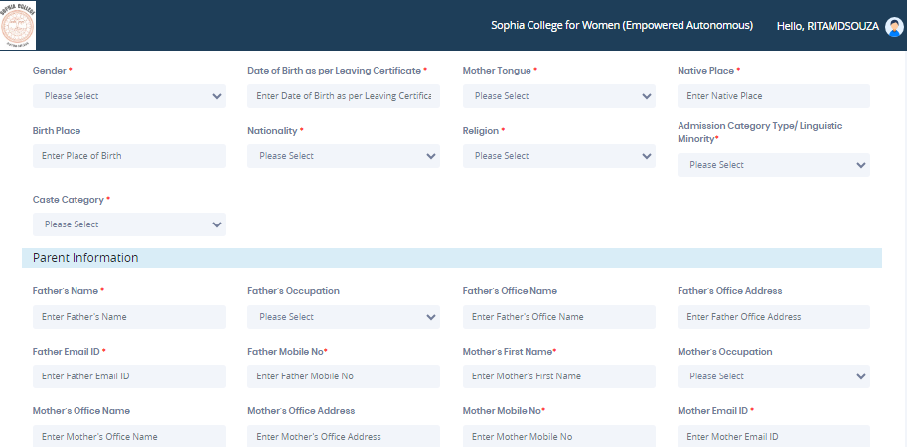
PERSONAL DETAILS
Step7: Once the student complete filling the personal details then they need to click on “Save and Next Button". (Please note that all the red mark fields are mandatory).

Slide 10
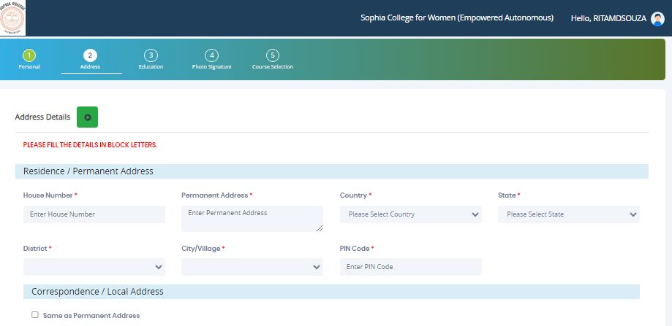
ADDRESS DETAILS
Step8: Next page is Address Details Page, here student need to fill their Personal or Local address. Once the student complete filling the personal details then they need to click on “Save and Next Button". If both Address are Same then click on “Same as Permanent Address” option present on screen. Once student complete filling the address details form then click on “Save and Next Button".

Slide 11
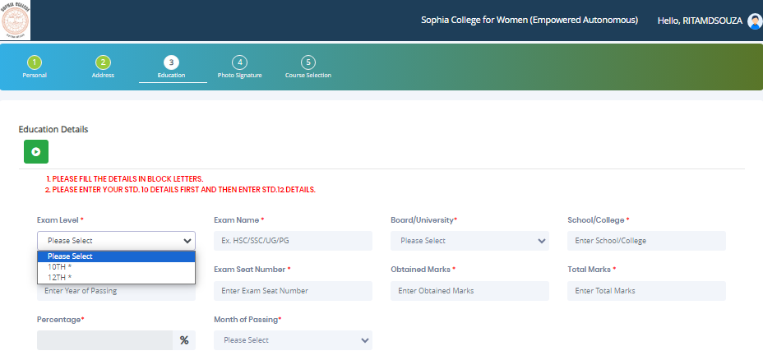
EDUCATION DETAILS
Step9: Next page is Education Details Page, here student need to fill the Education Details of the Last School/College attended,Exam Level,Exam Name,Board,etc. Further click on "Add" button to add the Education Details. Exam level 10th and 12th both are mandatory to fill. (Note: Student can add multiple Education Details as Per the College Requirement).

Slide 12
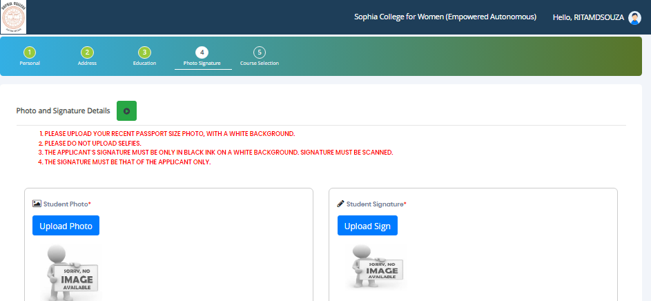
PHOTO & SIGNATURE DETAILS
Next page is Photo and Signature Page, here student need to Upload Your Photo and Signature. Click on the Upload Photo and Upload Signature button and select the valid file. Once you complete uploading photo and signature then click on “Save and Next Button". (Note: photo size should be max 500kb and Signature size should be max 300kb).

Slide 13
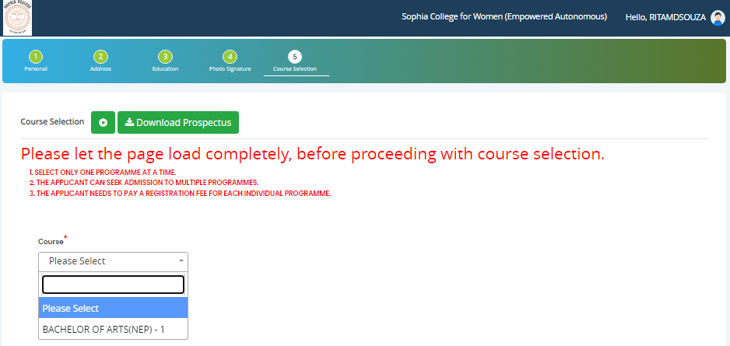
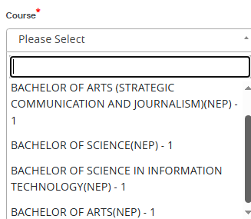
COURSE SELECTION
Step 10: Next page is Select the course
Click on “Save and Next” Button to proceed further.

Slide 14
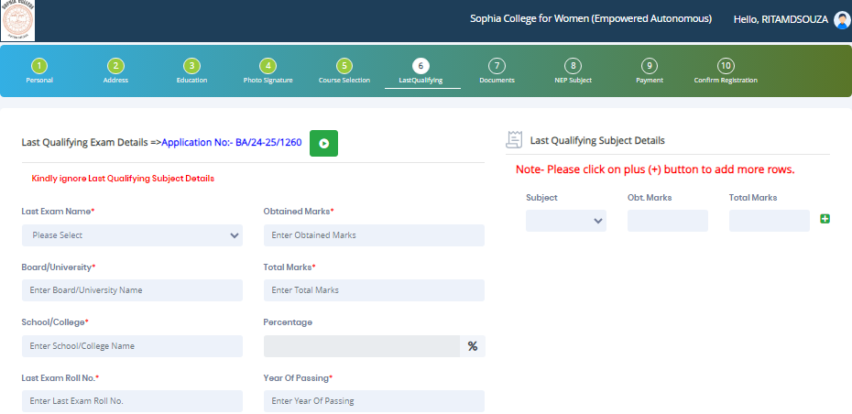
LAST QUALIFING EXAM DETAILS
Step 11: Next page is Last Qualifying Exam Details: Here 12th Class details need to be added.
Click on “Save and Next” Button to proceed further.

Slide 15
DOCUMENT DETAILS
Step11: Next page is Document Details Page, here student need to submit all the Required Documents which are Mandatory. Click on the Upload Documents button and select the Desired Document which students want to upload. Once students complete submitting all the documents then they need to click on “Submit Button". (Note: Document max size should 200kb)

Slide 16
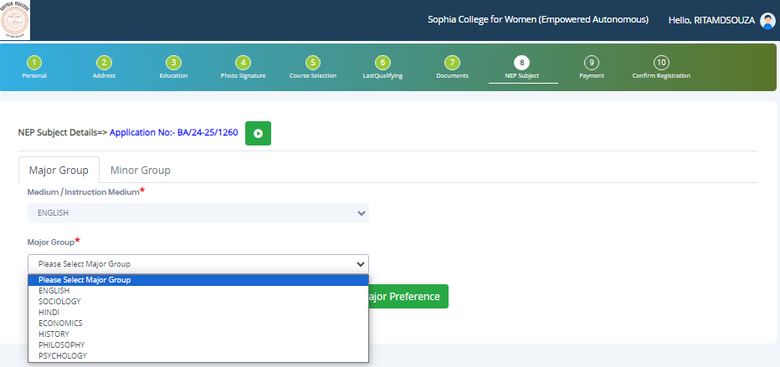
FYBA NEP SUBJECT DETAILS : 3 choices allowed

Slide 17
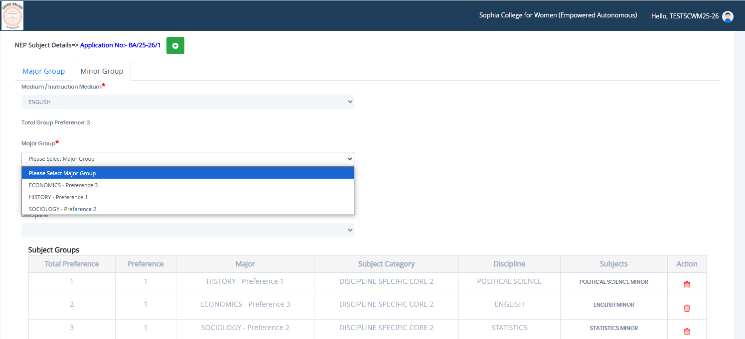
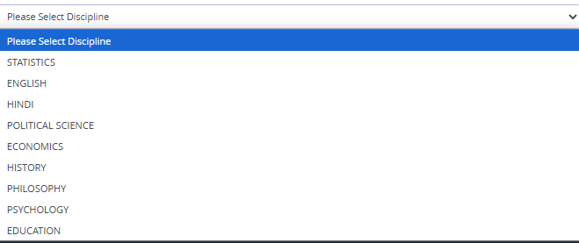
FYBA NEP SUBJECT DETAILS : 3 choices allowed
Select Minor Group add Minor Discipline against every major selected

Slide 18
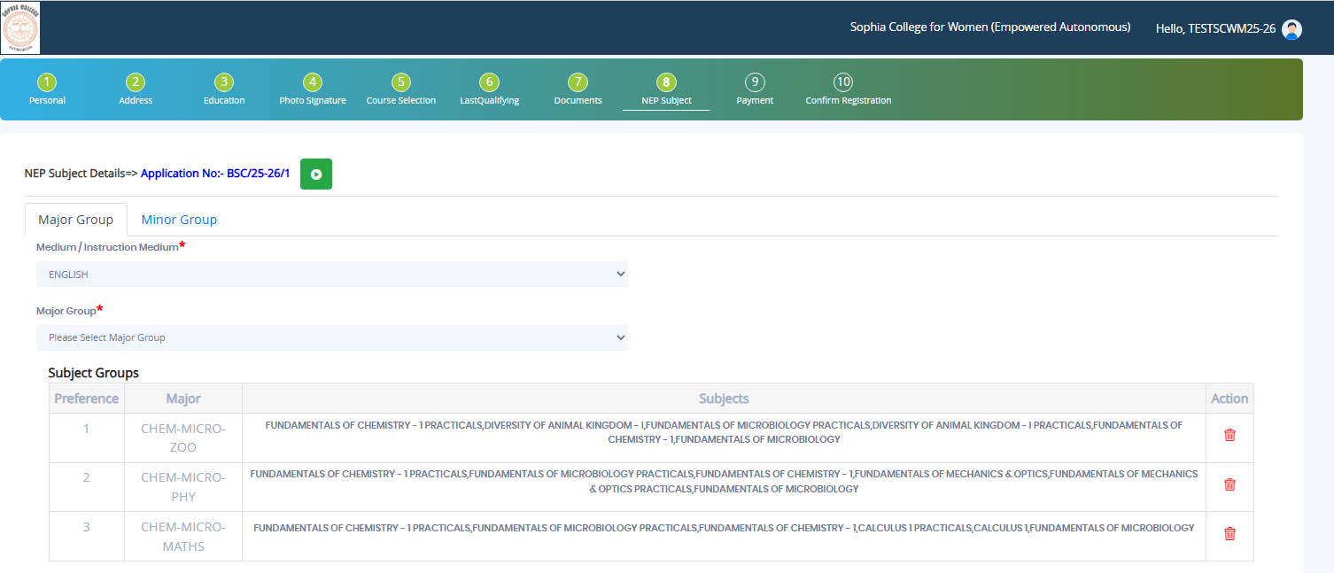
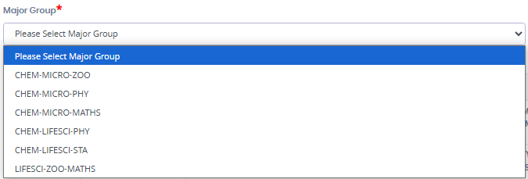
FYBSc NEP SUBJECT DETAILS : 3 choices allowed
Select Major Group Only (Please note Minor Group is not applicable for FYBSc. Students)

Slide 19
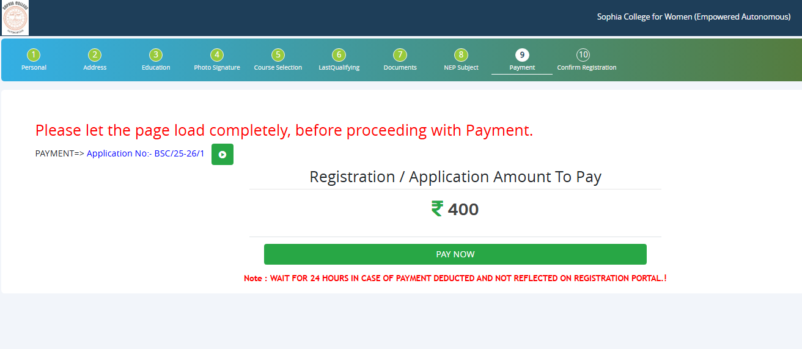
PAYMENT
Step 12: Please click on “PAY NOW” button to complete the Payment process

Slide 20
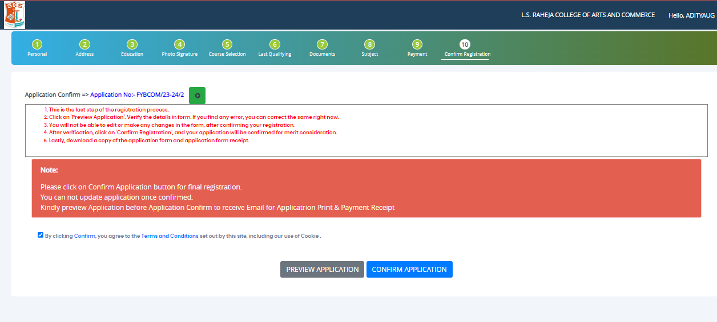
PREVIEW/CONFIRM APPLICATION
STEP 13: Click on ‘PREVIEW APPLICATION’ button to check all the details entered by you in the form are correct. If any Correction is there then please do the necessary changes and Click on ‘CONFIRM APPLICATION’

Slide 21
THANK YOU

